Slide 1
Organizing Production Facilities for Deep Processing of Amaranth
RUSOLIVA LTD.
VORONEZH

Slide 2
Aim of the project
AIM OF THE PROJECT – the construction of innovative production facilities for deep processing of amaranth seed to receive gluten-free food products, proteine concentrates and pressed amaranth oil.
FOR THE REALISATION of the project it is planned to use 150 million RUR, of them 45 million RUR are the enterprise’s own funds and 105 million RUR are outward investments.
PROJECT PAY-BACK PERIOD – 30 months

Slide 3
Amaranth – a prospective agricultural crop
Amaranth was introduced for cultivating by the nations which inhabited Central and South America over five thousand years B.C.
Amaranth is a high-protein drought-resistant crop, gluten free and with a harvesting capacity of up to 3000 kg/ha.

Slide 4
The advantages of amaranth
Amaranth is a gluten-free crop, contains to 30% more protein than wheat, rice and oats and is well-balanced in amino acid composition.
Amaranth is a good source of dietic fibers, vitamins (А,В6,С,К,) and minerals of calcium, magnesium and phosphorus.
Amaranth oil exceeds other vegetable oils
in the content of squalene (up to 8%), possesses antioxidative immunological activity and regulates the cholesterol level.

Slide 5
Products and area of application
Product of amaranth processing | Application area | Product kinds
Flour | Food industry: baby nutrition, diet and preventive nutrition | Gluten-free products: bread, cookies, gingerbread, waffles, cereals, groats, crisp bread, extrusion products
Proteine concentrate | Food industry, compound feed industry | Vegetable lactose-free products, identic in their composition to dairy products
Amaranth oil | Pharmaceutical and cosmetic industry | Amaranth oil as a pharmaceutic substance and a raw material for cosmetic products

Slide 6
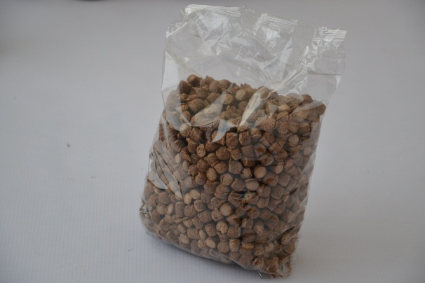
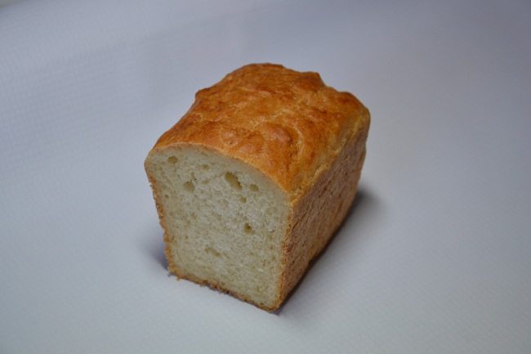
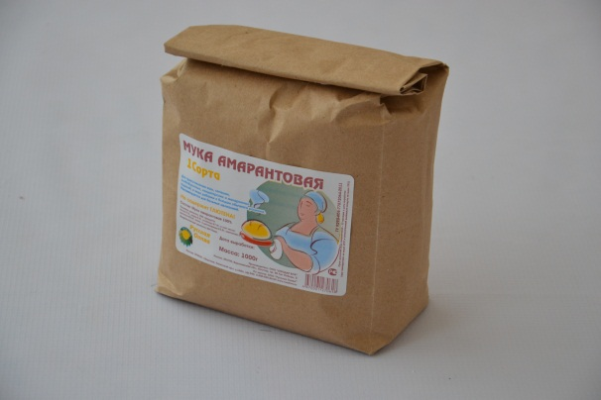
Amaranth products
Amaranth bran
Amaranth bran with cocoa
Amaranth bread
Amaranth flour

Slide 7
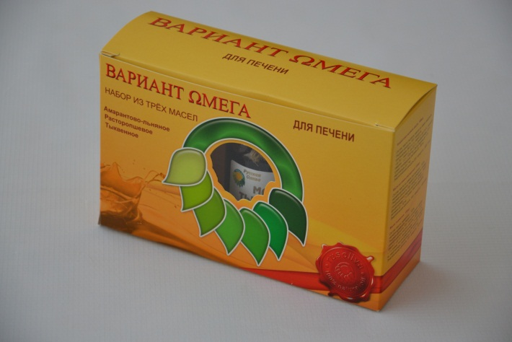
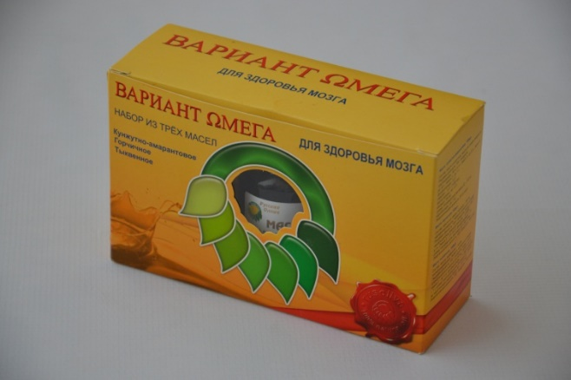
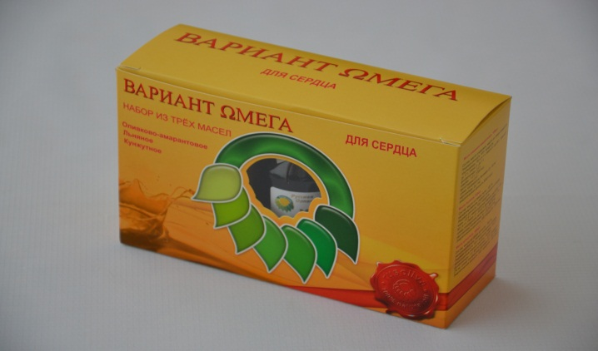
Products of Rusoliva Ltd.
Amaranth oil and oil sets

Slide 8
Conditions for project realization
Rusoliva Ltd. possesses 2 production departments for amaranth processing with the total cost of 15 million RUR
There is a business-plan developed for the construction of production facilities for deep processing of amaranth
For the plant construction there is a piece of land in Voronezh region with a square of 5 ha taken into lease.
Innovative highly profitable technology is protected by 7 inventions patents; trade marks are registered

Slide 9
Prospects of project development
Construction of the world’s first unique production facilities for deep processing of amaranth
Possibility of creating a joint venture and project development on the investor’s territory

Slide 10
Singularity of the project - possibilities
Creating infrastructural complex
Absence of world-wide analogues in the deep processing of amaranth
Small pay-back period of the project
Breeding new varieties of amaranth
Receiving a product with high added value
Low price of the final product
Creating a new export-oriented competitive product
Multifunctional product
Developing related industries

Slide 11
Investment rates
General amount of project investments: 150 million RUR
Including:
Capital investments 90 million RUR
Working capital and
product promotion 60 million RUR
Project income amount, with VAT 400 million RUR
(annually; annual project capacity – 5 thousand tons)
Project costs amount, with VAT 170 million RUR
(annually; annual project capacity – 5 thousand tons)
Pay-back period (simple) 2,5 years
Maximum capacity of the plant
for raw material processing 50.000 tons p.a.

Slide 12
RUSOLIVA Ltd.
www.rusoliva.ru
rusoliva@mail.ru
+7-800-555-3600
394033 Russia, Voronezh, Leninskiy prospekt 160a, Office 346

